Slide 1
Storytelling with Mapping:
Knight Lab StoryMap
GRMN 2102: Prof. Carolin Fuchs
Digital Integration Teaching Initiative

Slide 2
Workshop Agenda
Best practices and questions to consider before creating your StoryMap.
Learn about StoryMap as a mode of conveying data and content.
Demonstrate steps for using Knight Lab’s StoryMap.
Start building!
All materials + slides for this module can be found here: https://bit.ly/46eiVhn
For more information, please see: https://bit.ly/handout-storymap
Feel free to ask questions at any point during the presentation!

Slide 3
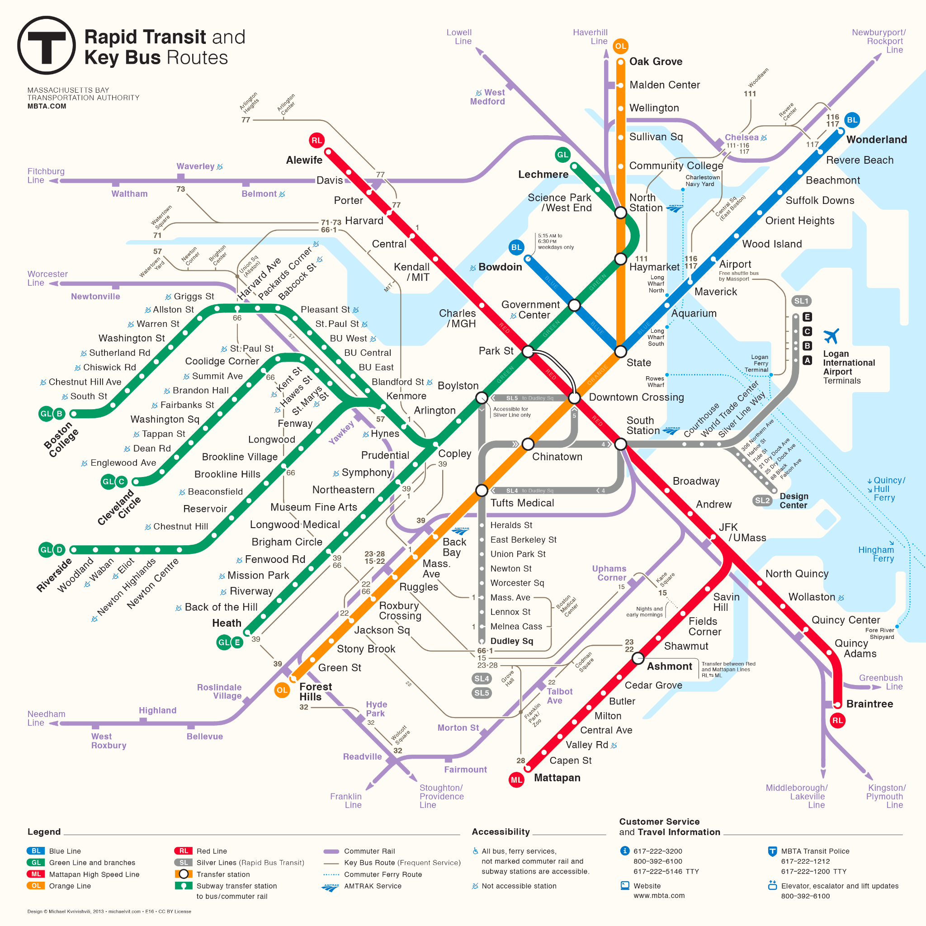
Maps’ different uses
Maps can convey all sorts of geospatial information that can facilitate different applications:
Navigational/orientational maps
Geological/topographical maps
Political maps
Thematic maps
Artistic maps
Narrative maps
Subway Map from MBTA

Slide 4
What are the limits?
Maps reflect the intention of the map-maker and are inherently limited.
Maps produce shared interpretations, and are not expressions of objective spatial relations.
Boston is as much a human idea as a physical space, and thus maps both represent and create reality. See Quincy Langford’s “Maps Are a Tool to Understand the Past and Shape the Future” to explore how maps can create, erase, and reshape.
The simplicity and clarity of maps is deceiving, but artificial clarity is necessary for the map to be useful.

Slide 5
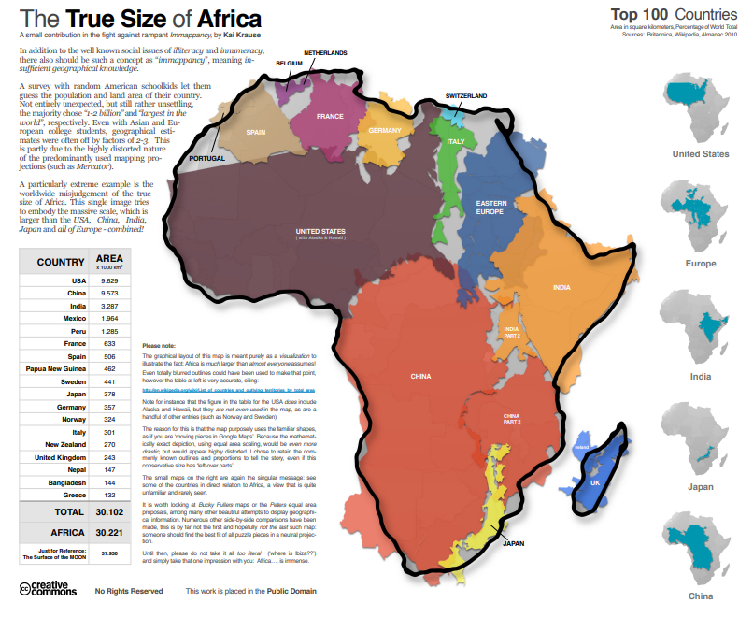
Questions for critiquing maps
What is its subject?
Who is/are the map’s audience(s)?
What is its message, argument, or purpose?
How and when was the map made?
Who made this map? What choices did they make?
From “Critiquing Maps II”, by Shannon Mattern
The True Size of Africa, Kai Krause

Slide 6
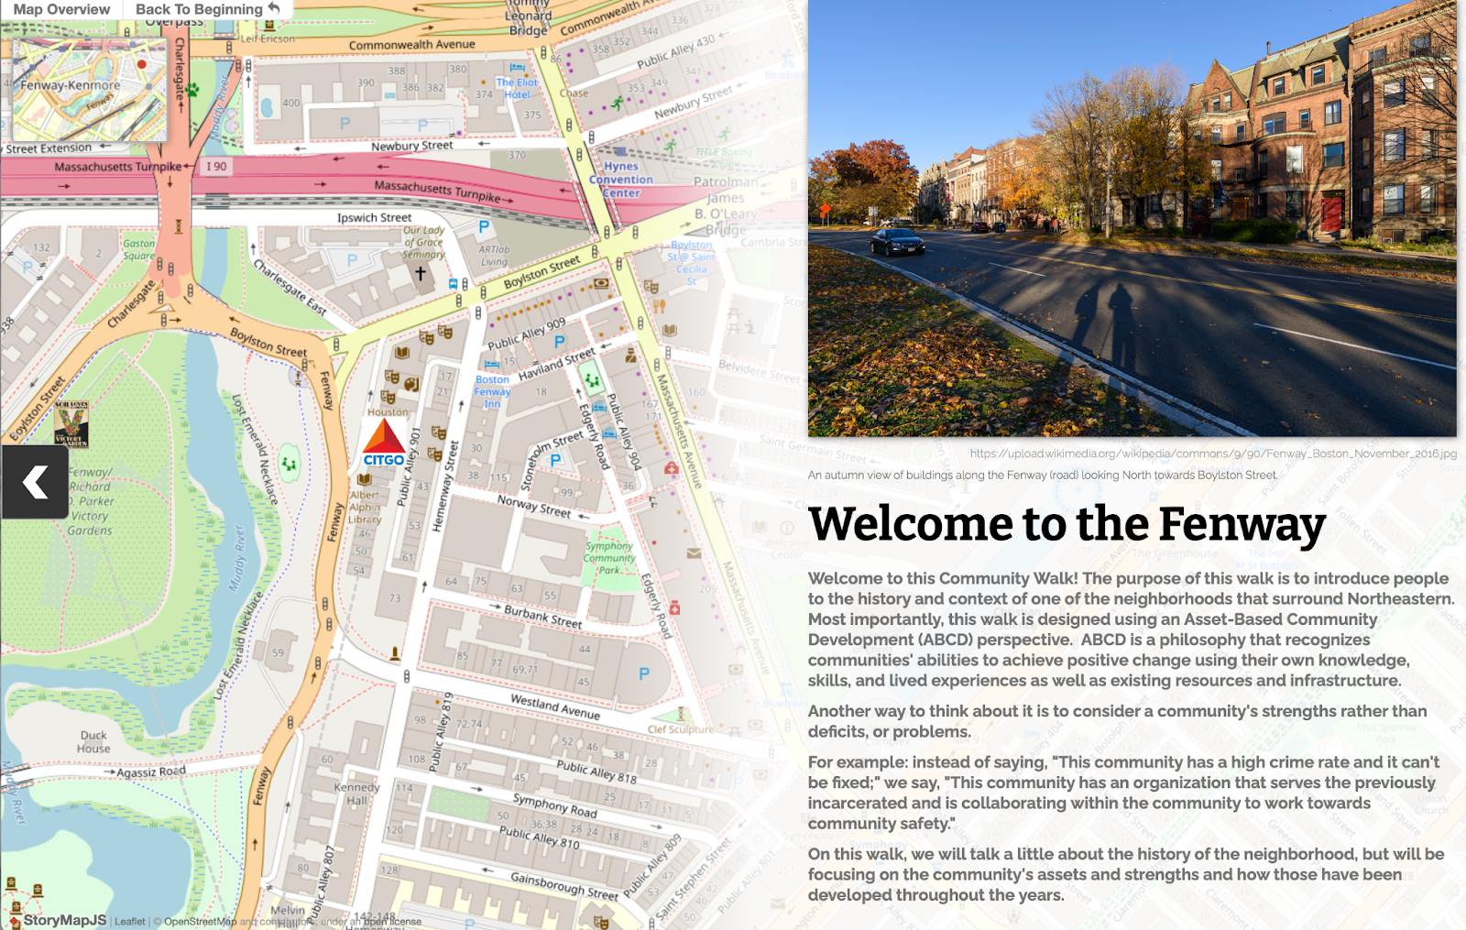
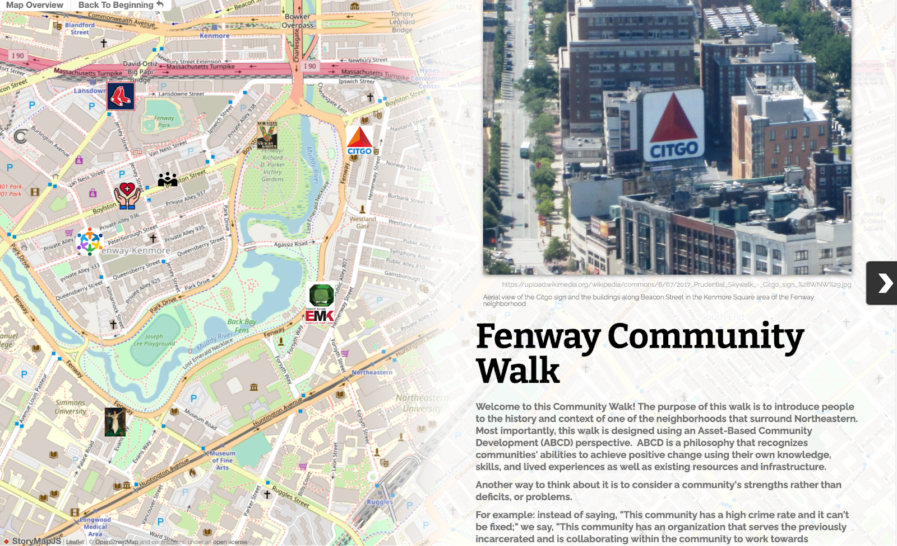
What is a StoryMap?
KnightLab’s StoryMap tool allows users to tell narrative stories connected with specific geographic locations.

Slide 7
Why use a map to tell stories?
StoryMaps help us render visualized, spatialized, and contextual information about spaces in the past or today.
StoryMaps can be about places you’ve never been to. The goal is to help users “see” the spaces/places/routes as accurately as possible, and to get a sense of the people and things in the environment.
Think about StoryMaps as giving directions, relating not only direction and distance but also sequence.

Slide 8
Example Projects Using Maps to Tell Stories
“The Black Jazz Heritage Trail of Boston”: uses a mix of textual, image, and student-researched location data to map historic Black jazz clubs.
“Mapping Shared Spaces: A Visual History of Boston’s Black and Jewish Communities”: presents the story of migration of Boston religious communities by following the changing locations of places of worship.
“Contemporary Indigenous Spatiality”: created by Agléška Cohen-Rencountre (Lower Brule Sioux Tribe) to interrogate settler-colonial epistemologies about water-ways, as well as trace personal and community connections to Rapid Creek and the Mississippi River.

Slide 9
Making a StoryMap

Slide 10
StoryMap Best Practices
Think carefully about the audience you are trying to reach with your map. This will impact your language, the order of your points, and the media that you choose.
Think also about the tone of the map: the default for StoryMap can be very upbeat and informal, and that may not match the content you are sharing.
Test your map after you have created it, to make sure that all the narrative points flow and that the language is clear and concise.

Slide 11
Optional: Spreadsheet Template
Make a copy of the StoryMap template below and use it to fill in the different sites you want to map, images you want to include, etc.
StoryMap Spreadsheet Template
Template based on the StoryMap Spreadsheet Template created by Molly Brown, Reference and Outreach Archivist, Northeastern University Library.
For more information about collecting and organizing data for StoryMap, please see:
https://bit.ly/handout-storymap-spreadsheet

Slide 12
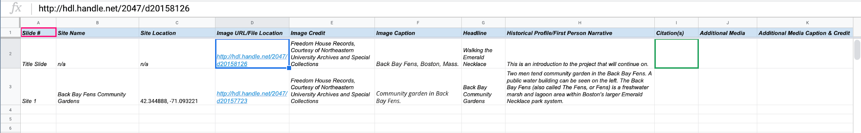
Spreadsheet data collection
The slide number can serve as the order in which your sites appear on your map and the site name can be used to label sites on your map.
2. The site location is used to identify a point on your map where the site is physically located (address or coordinates).
3. The image URL/File location is useful in keeping track of images of sites. Always credit your images to indicate their origin. Also include a caption describing your image.
4. The headline can serve as the official title or label of your site. Including a narrative provides more context as to why each location is important for your narrative.
5. Don’t forget to cite your sources! Also, you may want to include additional media related to your site (e.g. newspaper clippings, additional photos, etc.).

Slide 13
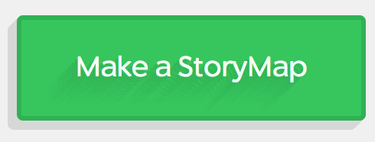
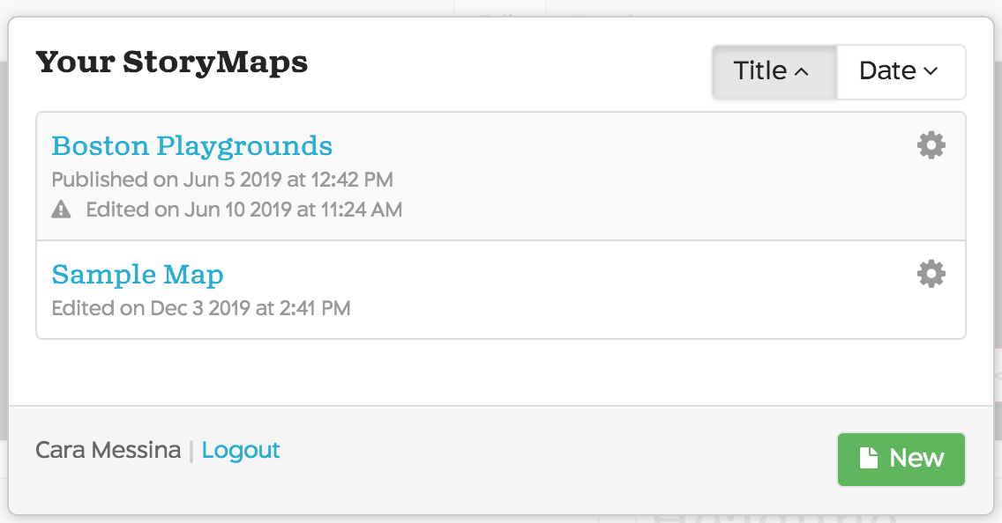
Create a StoryMap
Go to https://storymap.knightlab.com/
Click “Make a StoryMap.”
Either create a new account or sign in through Google.
Once you’re signed in, click “New Map” (once you have created your map, it will be there for you to work on).
Name your project.

Slide 14
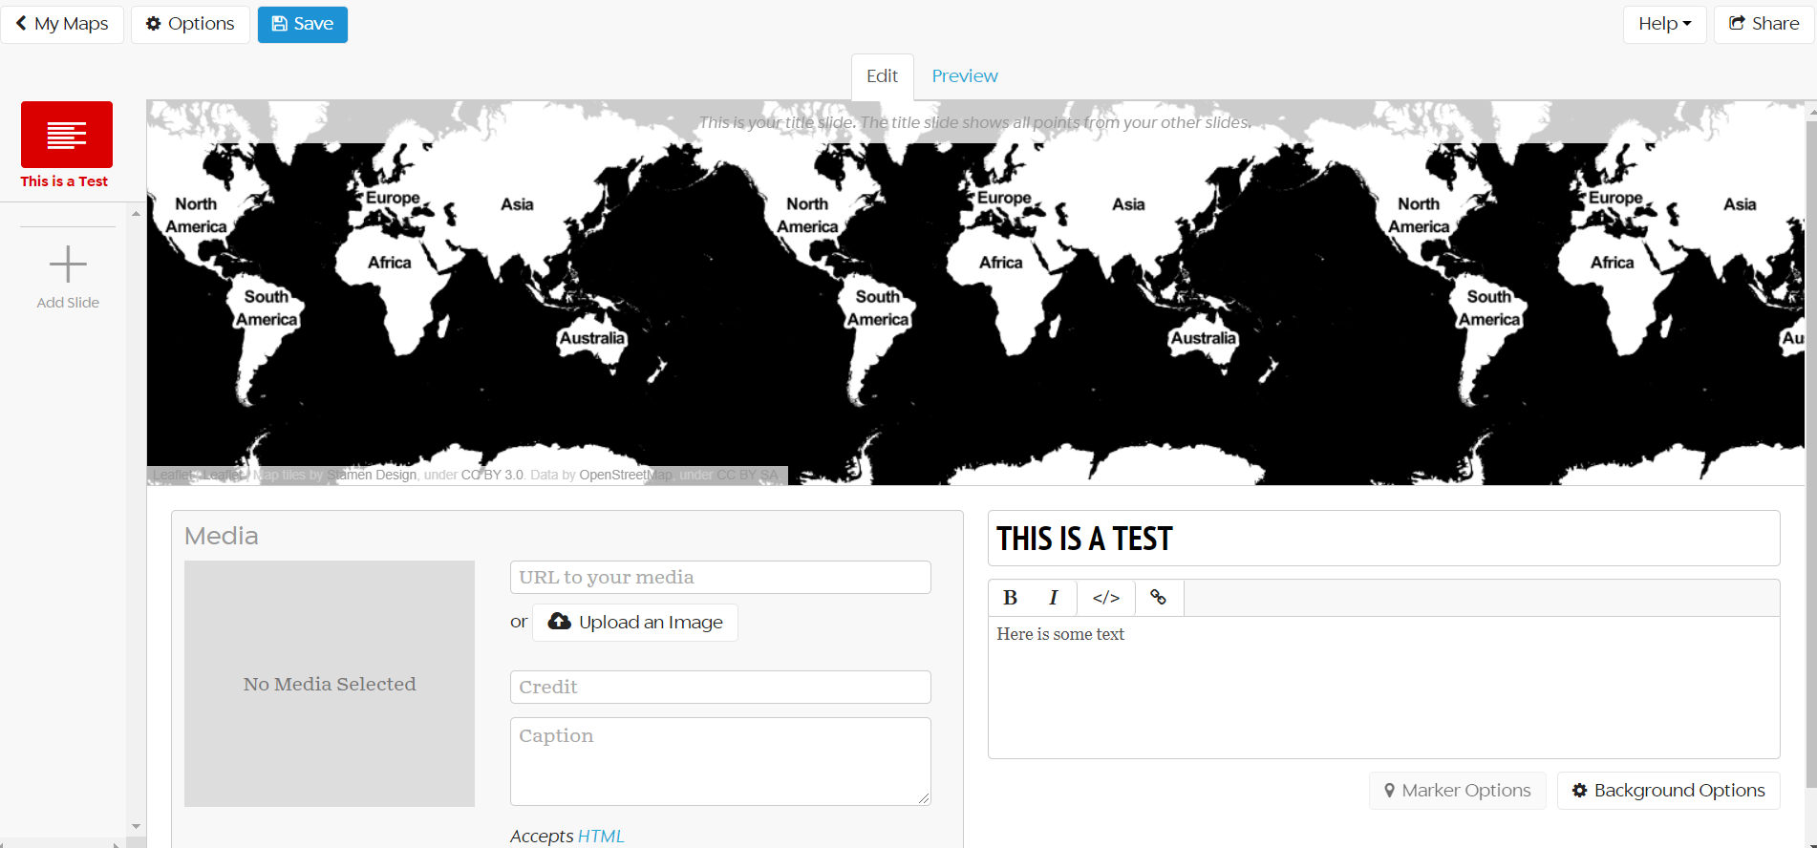
Your StoryMap
Overall options (like changing map layout)
SAVE OFTEN!
Preview your slides
Preview the geographic points in all of your slides
Title and content of your text box
Check out and add new slides here
Uploading photos or other media! Document what you upload
Color or image for text box background

Slide 15
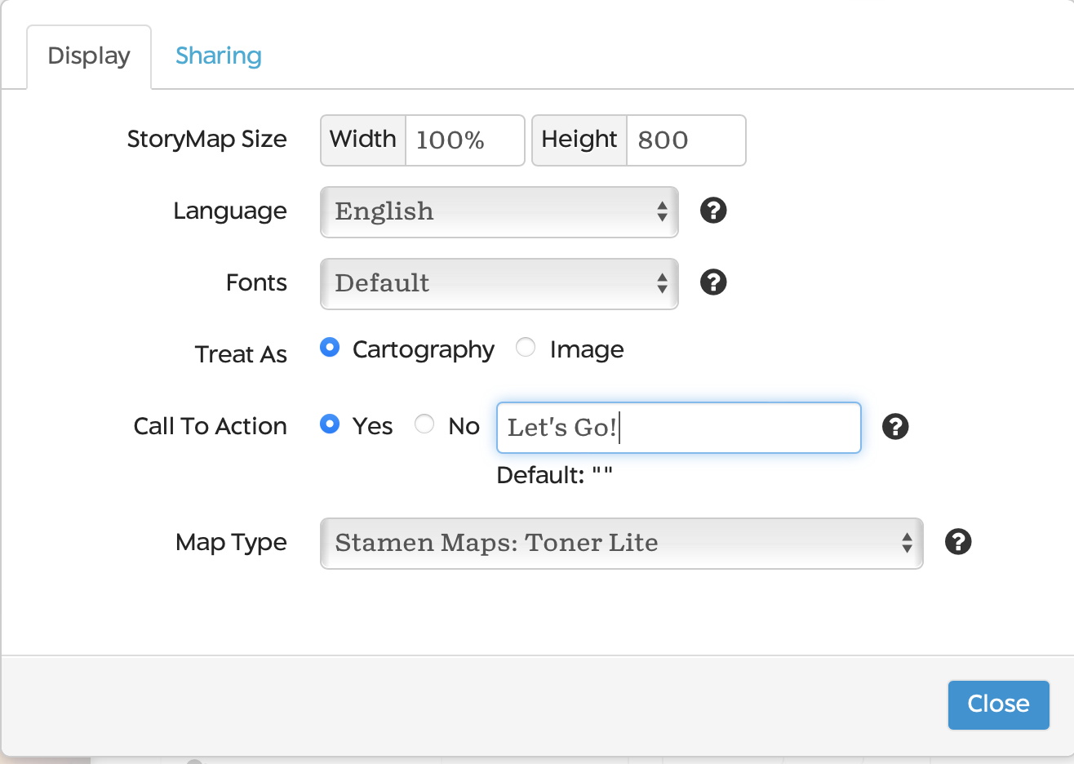
Options for designing your map
The “Options” button in the top left allows you to change the design of your map.
Customizable options include Language, Fonts, Call to Action, Map Type and more.

Slide 16
Slides, or map markers
Each slide is a different marker point on your map. Each slide contains:
Title and text. The text box reads basic HTML.
A background image or color.
A map marker, which can be placed by searching for Google Maps locations or by placing the marker manually.
Media: images, videos, and sound files can be uploaded. Since only one media file can be uploaded per slide, you can use the text box’s HTML to integrate additional images or other media types.

Slide 17
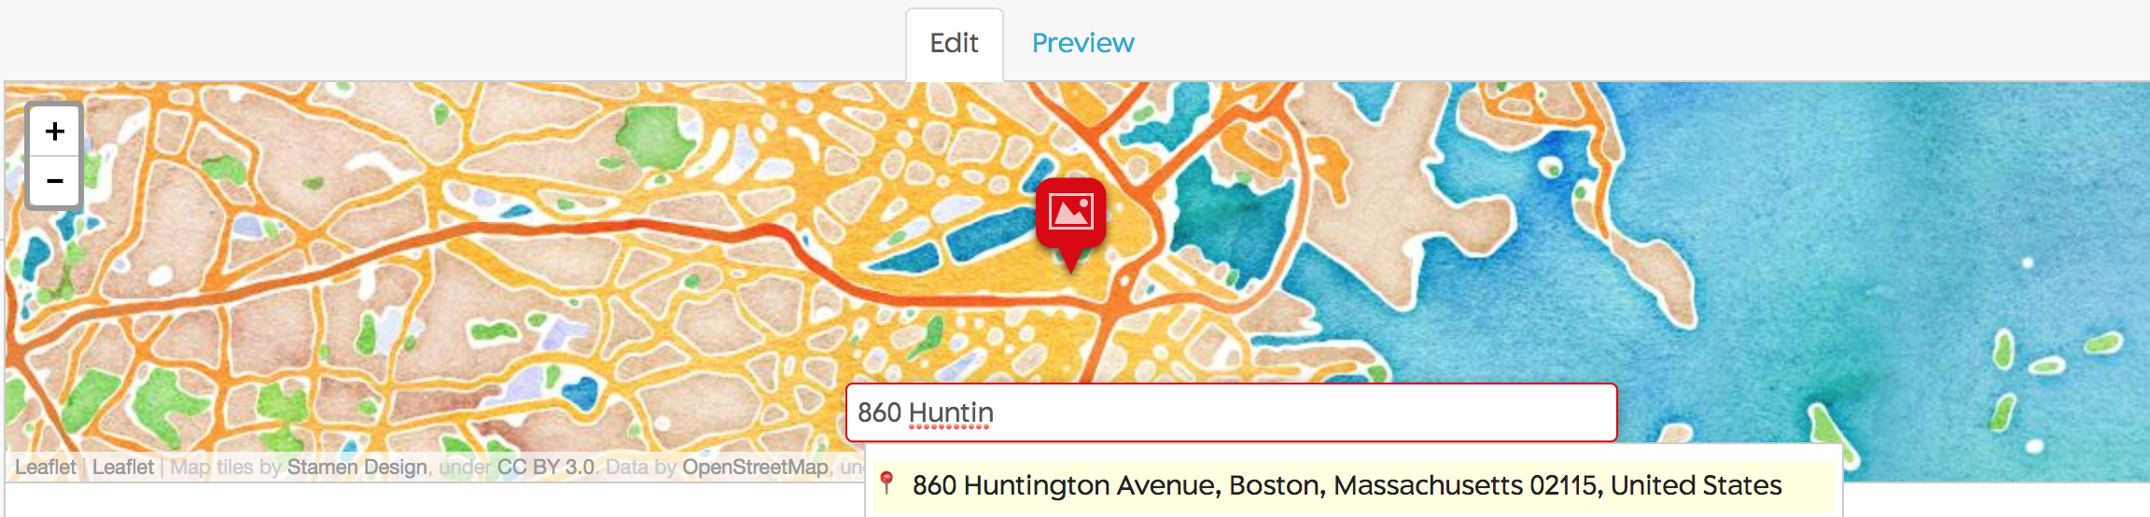
Add A Location
KnightLab StoryMap uses Google Maps to locate addresses
StoryMap, however, does not always recognize place names; you might need to know the address or location of particular structures
You can also drag and drop the map markers to the specific location

Slide 18
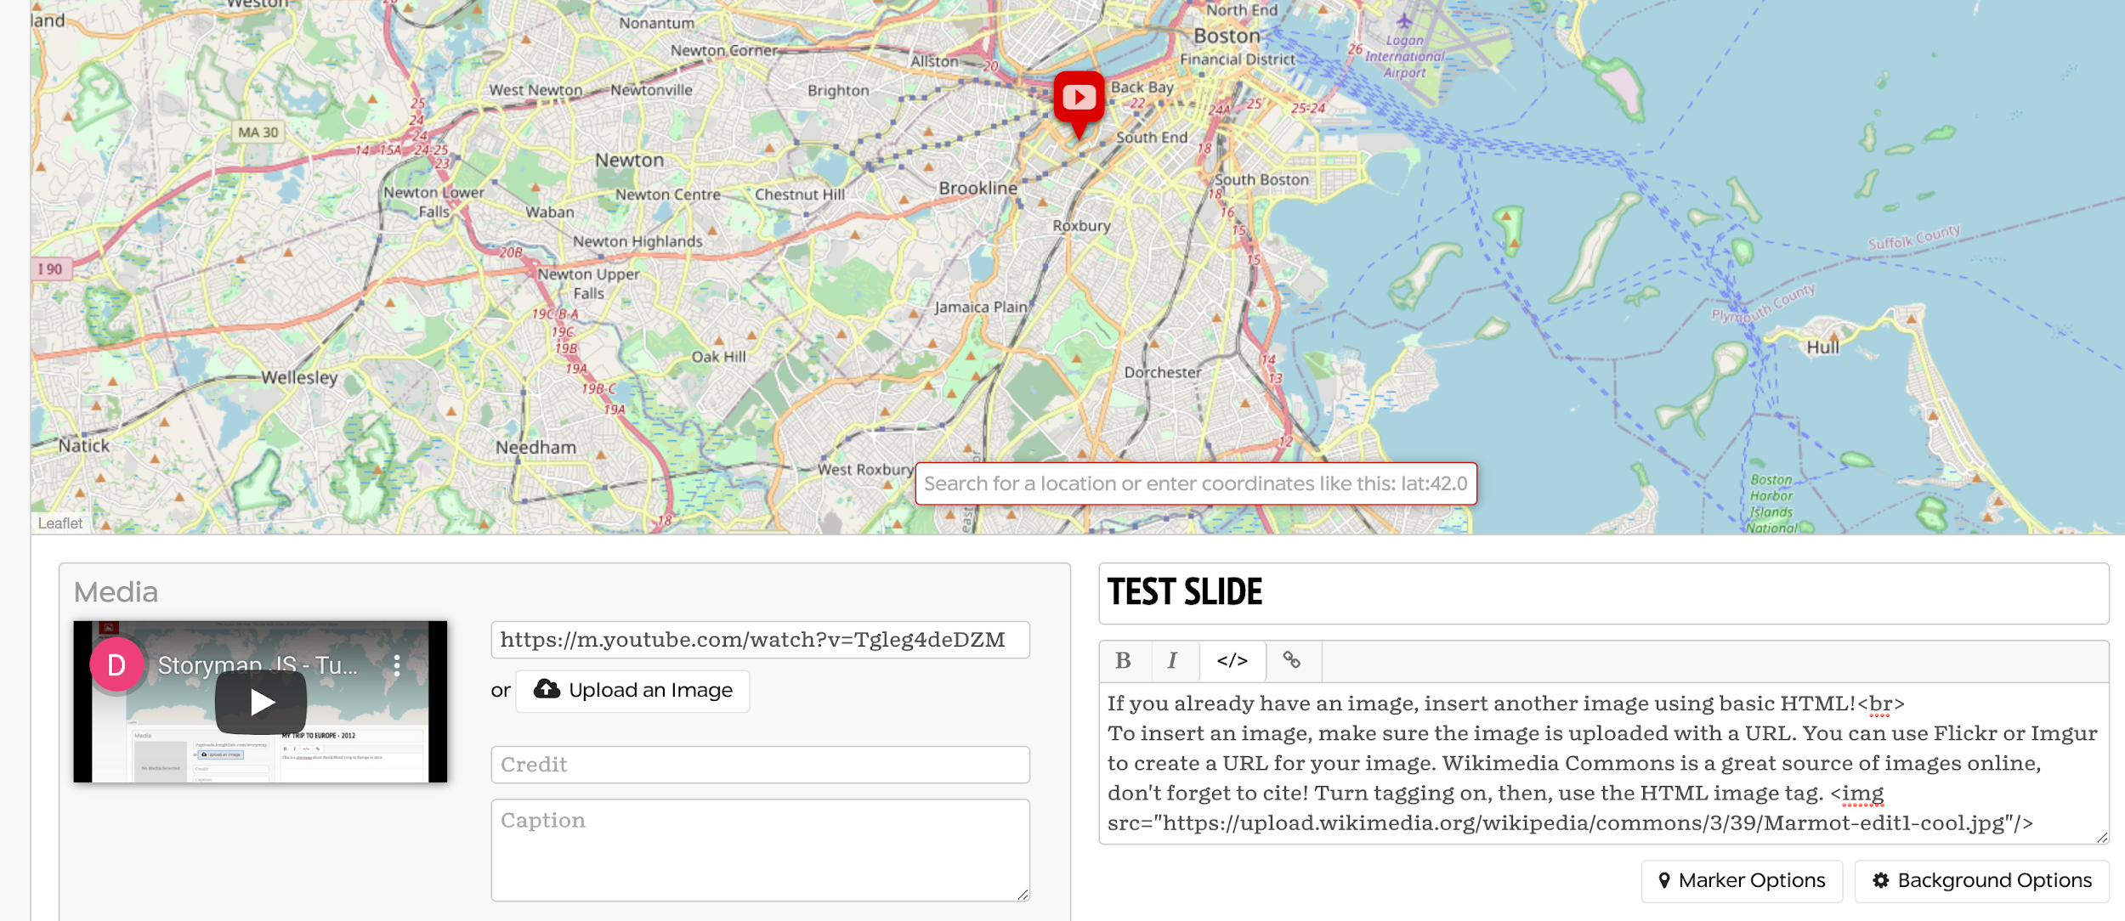
Add Media and Images to a Slide
If you have an image or a video in the “media” section, but want to include an image in the text, you can! The text box reads basic HTML.
Click the </> button (turn on HTML)
Get a URL of your image. Use Wikimedia Commons to search images by content, and filter by license type and image size. Make sure to use the embed file code, and don’t forget to cite the source!
Use the HTML <img src="URL"/> tag to insert the image.
Check the “Preview” to see the image. Smaller image sizes may appear as a thumbnail, so stick to larger image sizes and preview your end result!
Use “media” to upload files. You can upload an image or put a URL of an image OR a video (like a YouTube video). If you want to include your own video, you will first have to upload it to YouTube or other online publisher and copy that link.

Slide 19
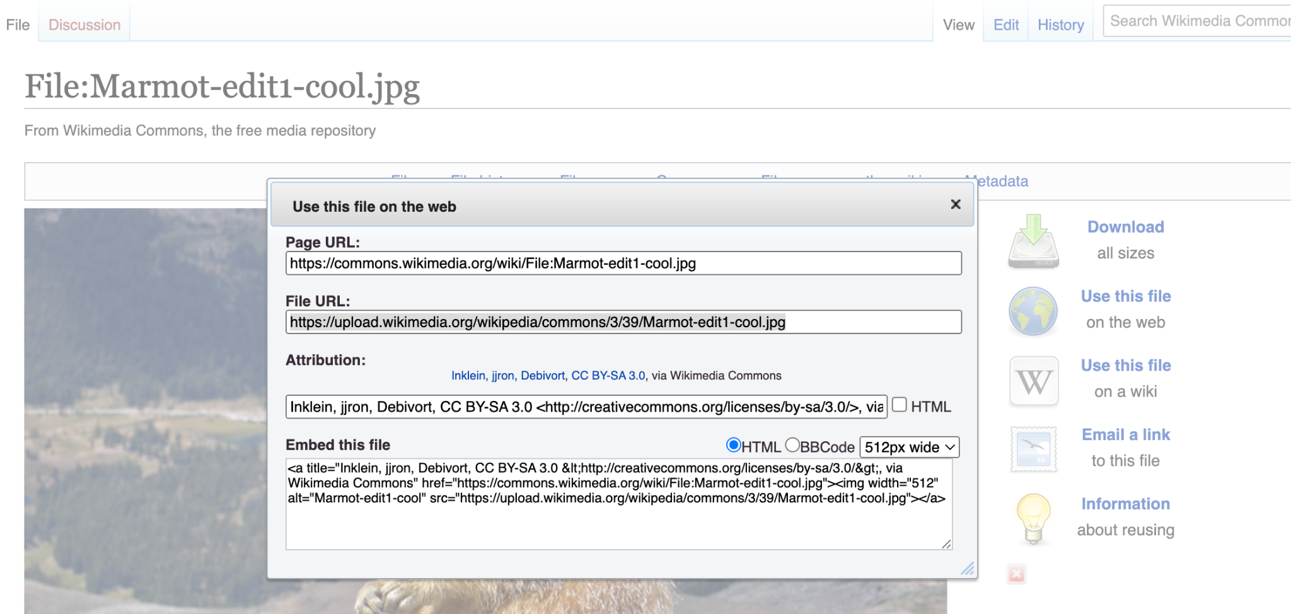
Embed codes and image files
If you are adding an image via its URL, make sure that you select the link with the image file itself, not just a page with the image on it.
For example, to add an image from Wikimedia Commons, follow these steps:
Go to "More Details" and choose "Use this file on the web," or just choose "Use this file on the web" if you see that option.
Copy the "File URL."

Slide 20
Image sharing and permissions
It is important to verify that you are allowed to use images before you put them in your StoryMap.
Search for media that is public domain or shared with permissions that allow re-use.
DITI recommends Wikimedia Commons and DPLA (Digital Public Library of America).
Ensure proper credit/attribution is given for all media
For more information on copyright and reuse, please see:
https://bit.ly/fair-use-handout

Slide 21
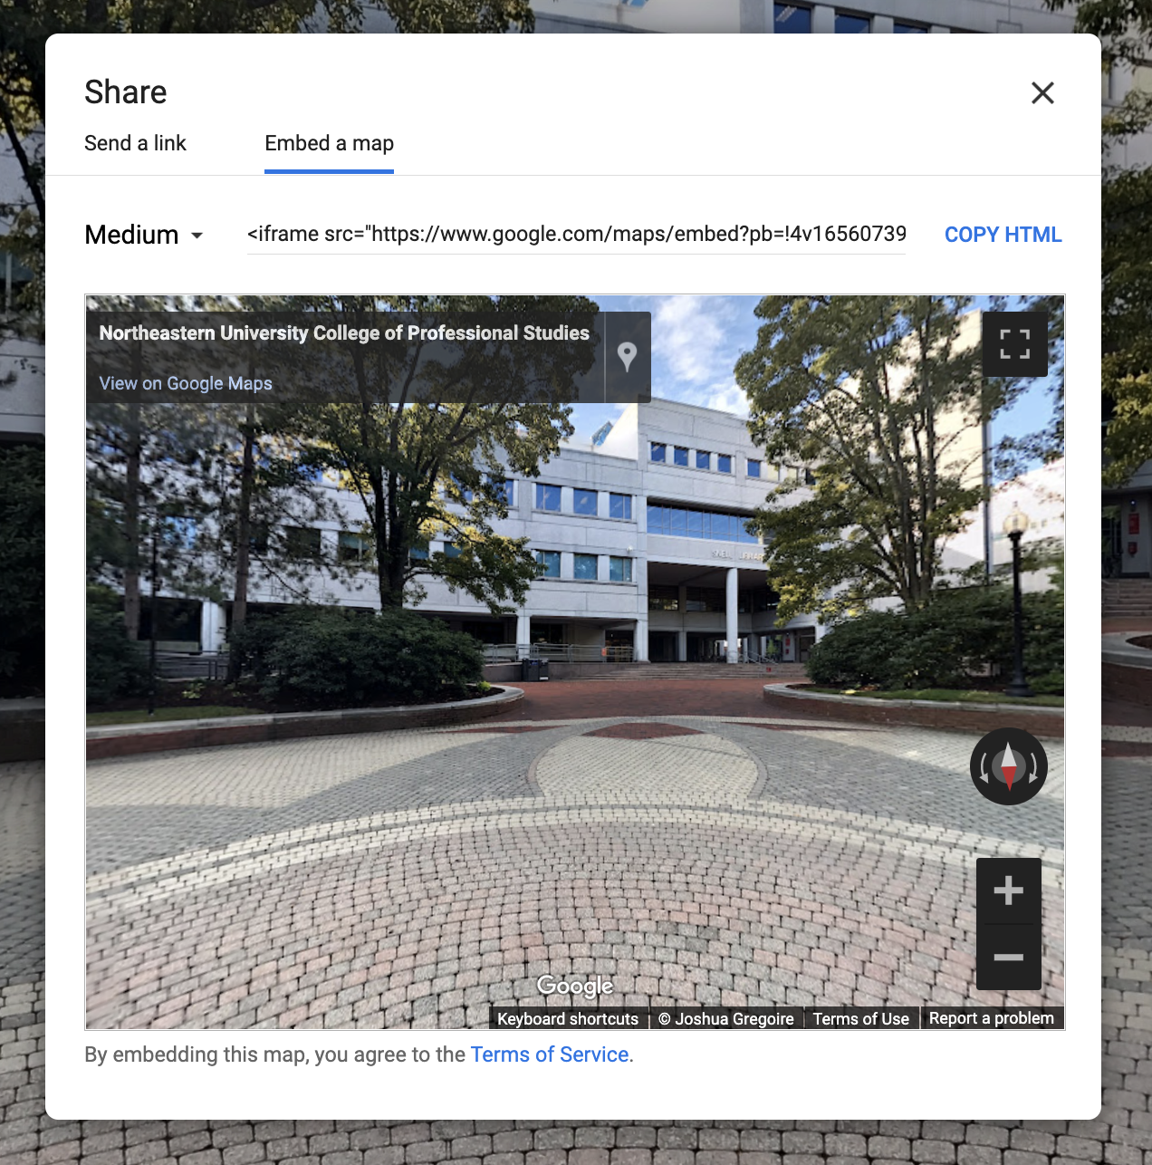
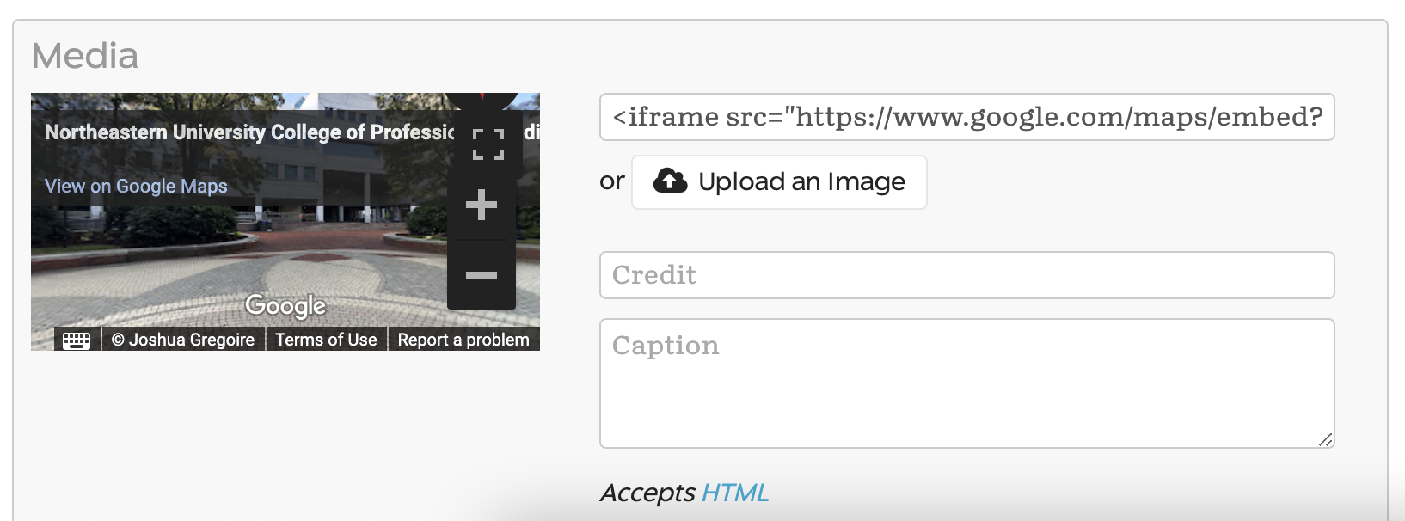
Add Google Street View to a Slide
As with other media, you can insert a Google street view map into a slide by entering its URL.
Click “Share or embed image” from the menu in Google Maps, and copy the HTML link from the “Embed a map” tab.
Make sure the link has the <iframe src:"URL"></iframe> code (it should automatically, but the map won’t work without it!).
Enter the URL into the “URL to your media” box.

Slide 22
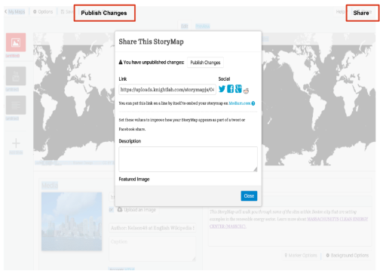
Publish and Share Your StoryMap
Click the “Publish Changes” button on the top left side on the editing page.
StoryMap’s “Share” button is in the top right corner.
You can add a description and feature image here before sharing your StoryMap widely.

Slide 23
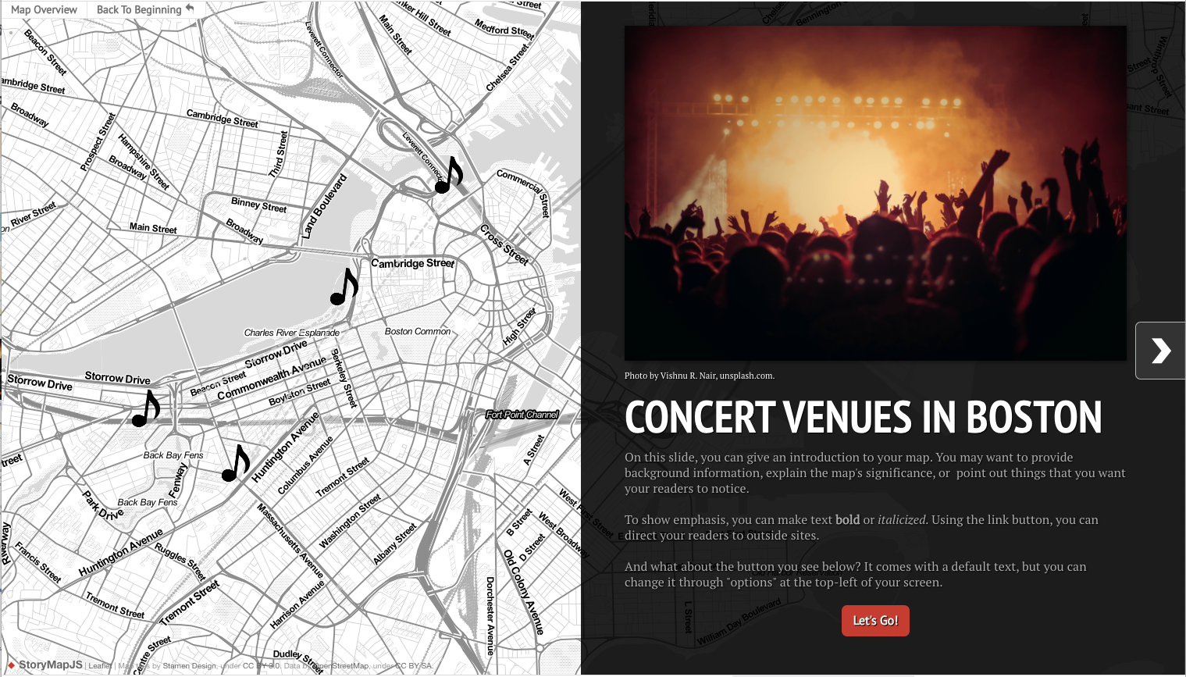
StoryMap Demo
To see StoryMap in action, click on this Sample Map Link!
Here you will be able to explore a map custom-made by DITI to highlight your options for creating maps.

Slide 24
Best Practices for StoryMap

Slide 25
Image sharing and permissions
It is important to verify that you are allowed to use images before you put them in your StoryMap.
Search for media that is public domain or shared with permissions that allow re-use.
DITI recommends Wikimedia Commons and DPLA (Digital Public Library of America).
Ensure proper credit/attribution is given for all media
For more information on copyright and reuse, please see:
https://bit.ly/fair-use-handout

Slide 26
Accessibility in StoryMap
Alt-text is a description of a digital image attached to the image file. People that use screen readers are able to hear content you include in:
Image captions
Text box (for embedded images and media)
If linking media, be sure to use a descriptive link name.
For more information on accessibility in StoryMap, please see:
https://bit.ly/storymap-accessibility-handout

Slide 27
Data Privacy
It’s important to pay attention to data privacy when using digital resources
At its simplest, data privacy is a person’s ability to control what of their personal information is shared and with whom.
To help you make informed decisions about interacting with digital tools in ways that honor your boundaries with your data and/or personal information, The DITI has prepared a handout on Data Privacy

Slide 28
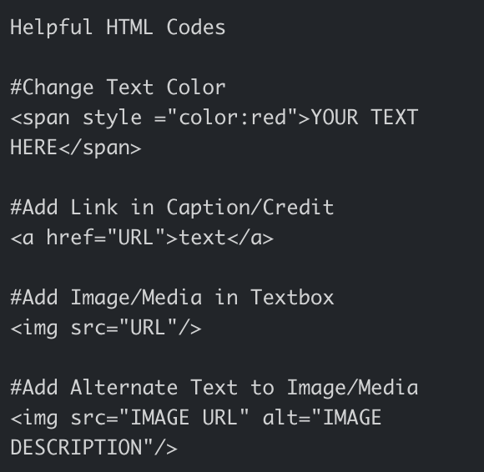

A Note on HTML
You can use HTML to have more control over the display and behavior of StoryMap. Look for the “Accepts HTML” language or this symbol:
For more information on HTML, please see: https://bit.ly/handout-HTML

Slide 29
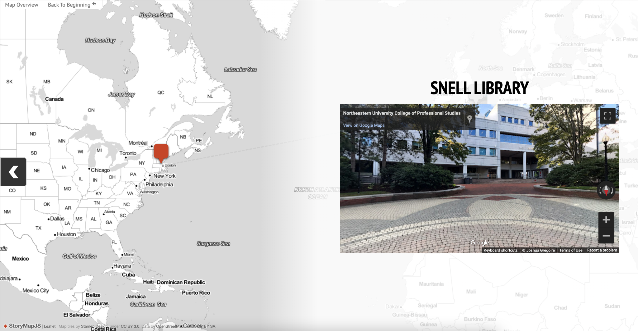
A Note on Zoom Levels
StoryMap does not let you set how far zoomed in or out your slides will be. The zoom level is determined automatically according to the distance between your locations.

Slide 30
A Note on Save States
StoryMap does not keep older versions of your project, so once you make and save changes, you cannot retrieve a previous version. You can also write over new content if you have your StoryMap open in multiple browser tabs or windows at once.
This is one reason why it is a good idea to plan out your StoryMap in a separate document: if you lose progress, you will have your content saved somewhere else.

Slide 31
For Further Exploration
Here are all the links presented in these slides:
https://bit.ly/handout-storymap
https://bit.ly/handout-storymap-spreadsheet
https://bit.ly/fair-use-handout
https://bit.ly/storymap-accessibility-handout
https://bit.ly/handout-HTML

Slide 32
Thank you!
—Developed by Ana Abraham, Chris McNulty, and Benjamin Grey
—Taught by Claire Lavarreda
For more information on DITI, please see: https://bit.ly/diti-about
Schedule an appointment with us! https://bit.ly/diti-meeting
If you have any questions, contact us at: nulab.info@gmail.com

